Slide 1

Improving Educational Experience of High School Students in Chicago

Slide 2
Introduction
In today’s job market, college degree is essential for many high-paying jobs .
However, there are many high school students in the United States who have been struggling to keep their grades high enough to enter colleges.
Based on an assumption that high school grades are positively related to college entrance, this project examines relationships between grades in high school and college enrollment rate in Chicago.
This project also tries to identify potential universities who could possibly provide educational services (mentoring or tutoring) to students in high schools who have the lowest grades.
This project may be utilized by high school teachers, parents, non-profit organizations, universities, and other community members to develop plans to provide educational services to high school students who have been struggling.

Slide 3
Data
Data is provided by Chicago Public Schools and is available from the website below:
https://data.cityofchicago.org/Education/Chicago-Public-Schools-Progress-Report-Cards-2011-/9xs2-f89t?cm_mmc=Email_Newsletter-_-Developer_Ed%2BTech-_-WW_WW-_-SkillsNetwork-Courses-IBMDeveloperSkillsNetwork-DB0201EN-SkillsNetwork-20127838&cm_mmca1=000026UJ&cm_mmca2=10006555&cm_mmca3=M12345678&cvosrc=email.Newsletter.M12345678&cvo_campaign=000026UJ
Due to limited availability of current data sets, data that was published in “Progress Report Cards (2011-2012)” was used.
The variables used for this project are:
“9th Grade EXPLORE (2010)(average score of EXPLORE test)”, “10th Grade PLAN (2010)(average score of PLAN test)”, “11th Grade Average ACT (2011)”, “College Eligibility %”, “Graduation Rate %”, and “College Enrollment Rate %”

Slide 4
Methodology
Conducted descriptive statistical analysis to see basic information (e.g., mean, standard deviation) of the dataset
Examined the relationship between the independent variables (academic scores of 9th, 10th, and 11th graders) and the dependent variable (% of college enrollment)
Used seaborn’s regplot method to plot data points and fit a linear model.
Conducted multiple regression analysis
Calculated R^2 score
Used K-Means Clustering to divide the high schools in Chicago into 4 groups, based on the academic scores
Used folium and geospatial data from Foursquare to plot universities that are located around high schools who are classified as having the lowest academic scores.

Slide 5
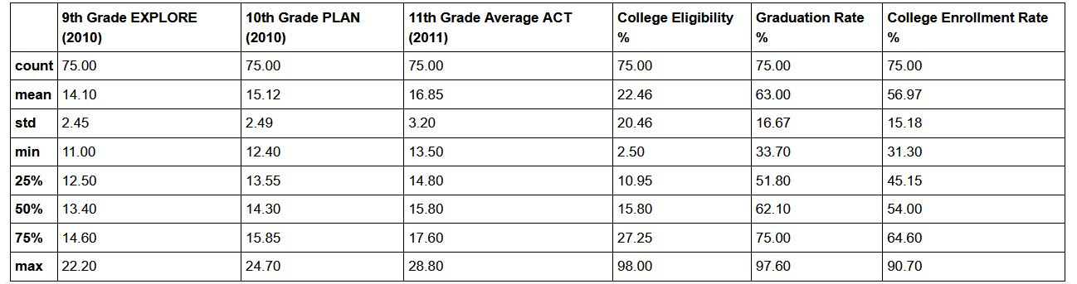
Results: Descriptive Analysis
Among 75 high schools in Chicago, means for the academic scores of the 9th, 10th, and 11th graders are 14.1, 15.12, and 16.85 respectively (the highest possible points for those tests are 35, 25, and 36).
Mean graduation rate % is 63. Graduation rate in IL in 2010-2011 is 83.8, so the rate in Chicago is appx. 20 percentage points lower than the state’s rate.

Slide 6
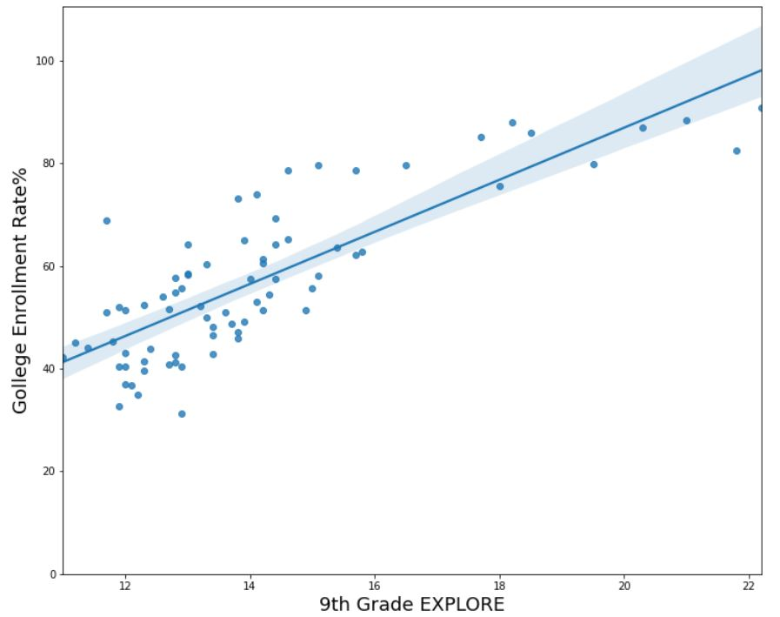
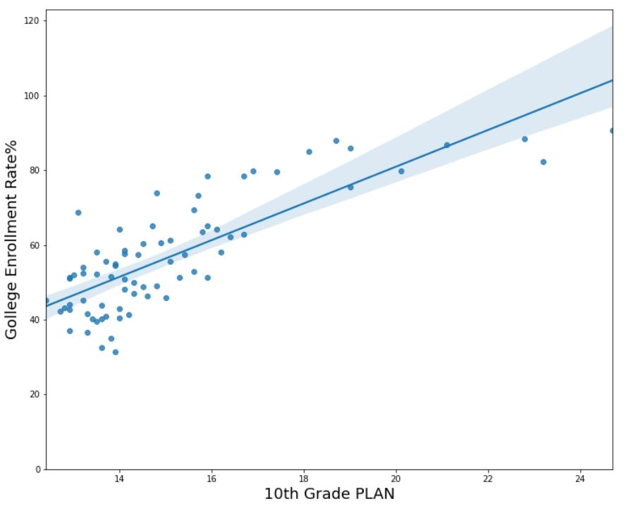
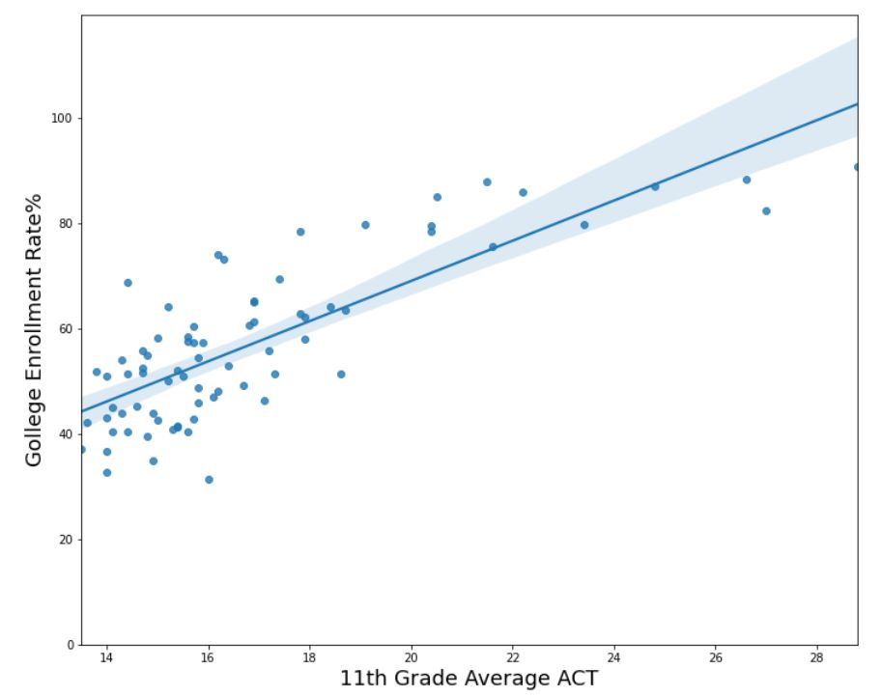
Results: Regression Plot
All the academic scores have positive relationships with the college enrollment rate %

Slide 7
Results: Multiple Regression Analysis
Regression analysis
Independent variables: 9th Grade EXPLORE (2010),10th Grade PLAN (2010), 11th Grade Average ACT (2011)
Dependent variable: collage enrollment rate
The R-square: 0.67
The model generated by using those academic scores explains 67% of the variability of the collage enrollment rate

Slide 8
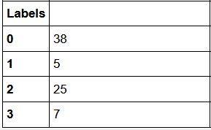
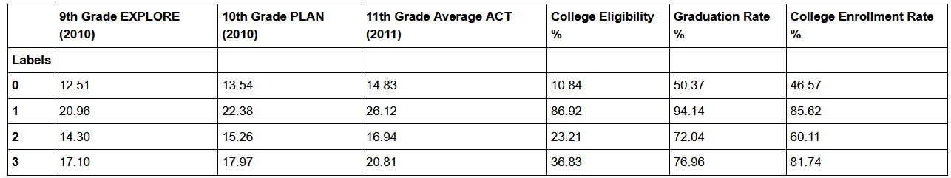
Results: Classifying High Schools into Four Groups
High schools are grouped into four groups, based on students’ academic scores.
Group 0 has the most schools (35 schools) and Group 3 has the least schools (5 schools).
The table below shows the schools in Group 0 has the lowest academic scores (9-11th), college eligibility, graduation rate, and collage enrollment rate.

Slide 9
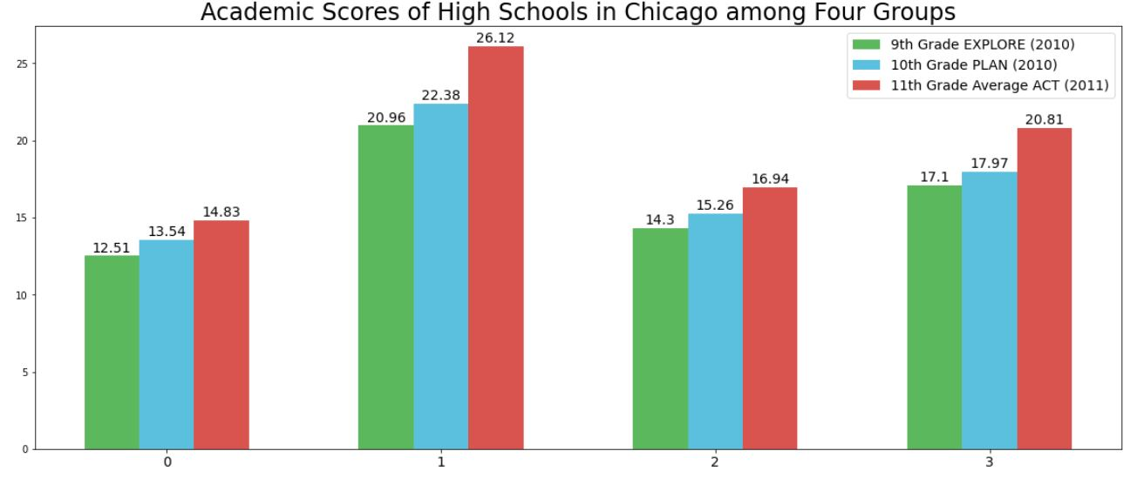
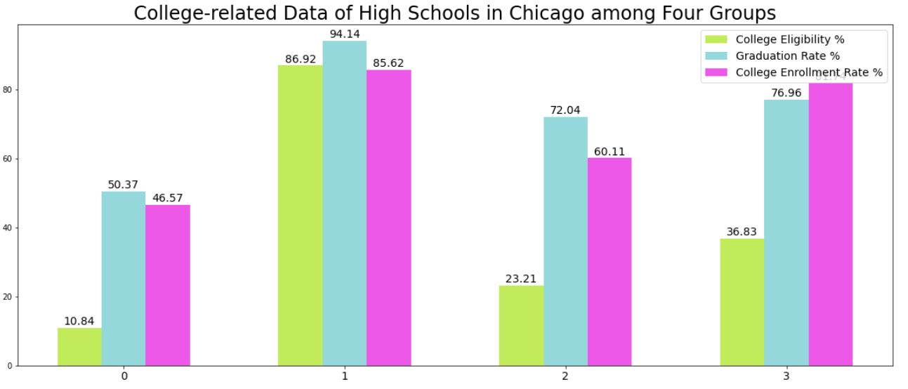
Results: Characteristics of the Four Groups
Group 0 has the lowest academic scores and college-related records
Will focus on schools in the Group 0 and see if there are any universities located near those high schools

Slide 10
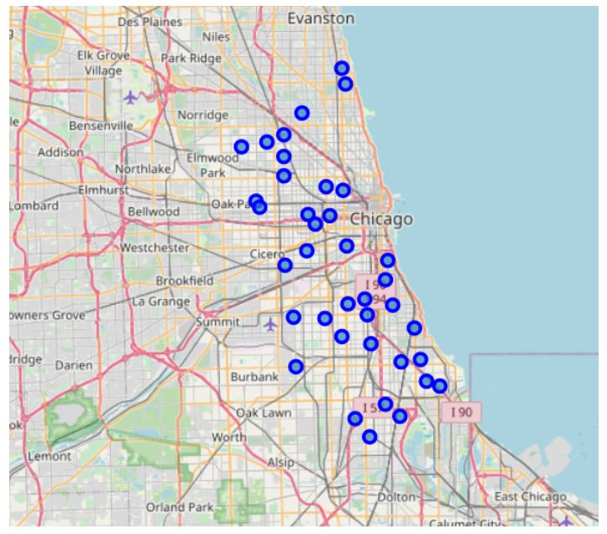
Results: Locations of High Schools in Group 0 (that has the lowest academic achievements)

Slide 11
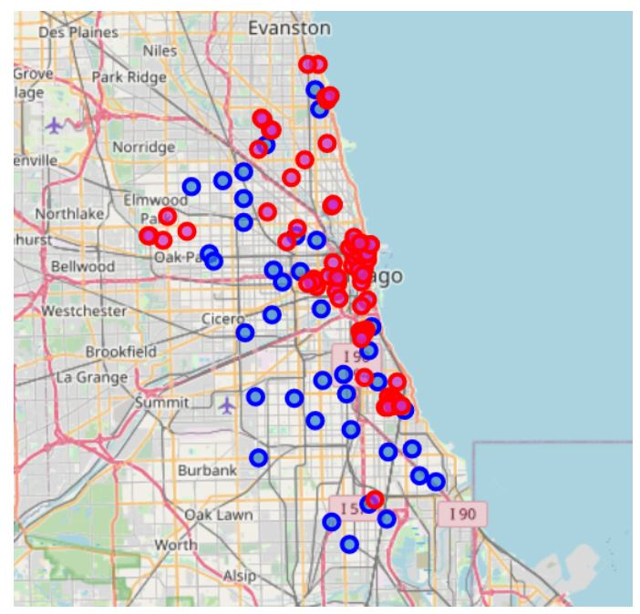
Results: Locations of Universities
Lots of universities at the center and northern part of Chicago but a few or no universities in the Southern part

Slide 12
Discussion
This project confirms the assumption that academic scores in high school are positively related to college enrollment rate.
The academic scores in high school explains 67% of the variability of the college enrollment rate.
It identified the challenges faced by some high schools, especially those in the southern part of Chicago due to limited possible opportunities to work with the universities (in terms of proximity).
Possible solutions:
Find university students who live close to those high schools
Online tutoring or mentoring services
Seek help from local communities or non-profit organizations, and focus on those specific high schools

Slide 13
Conclusion
The relationship between the academic scores and college enrollment rate was examined.
Locations of the High schools with low academic scores and the universities were plotted.
Even though some challenges and difficulties faced by specific high schools were shown, there are some possible solutions that could be discussed.
It is important to note that data analysis is not only to identify problems but also to suggest solutions for the future.

